Slide 1
Visual Presentation #3
By: Edward Arroyo, Jahbari Dessout, William Ferris, and Eliexer Gomez

Slide 2

Gen Fitness
The business we are consulting for is the nonprofit organization Gen Fitness.

Slide 3

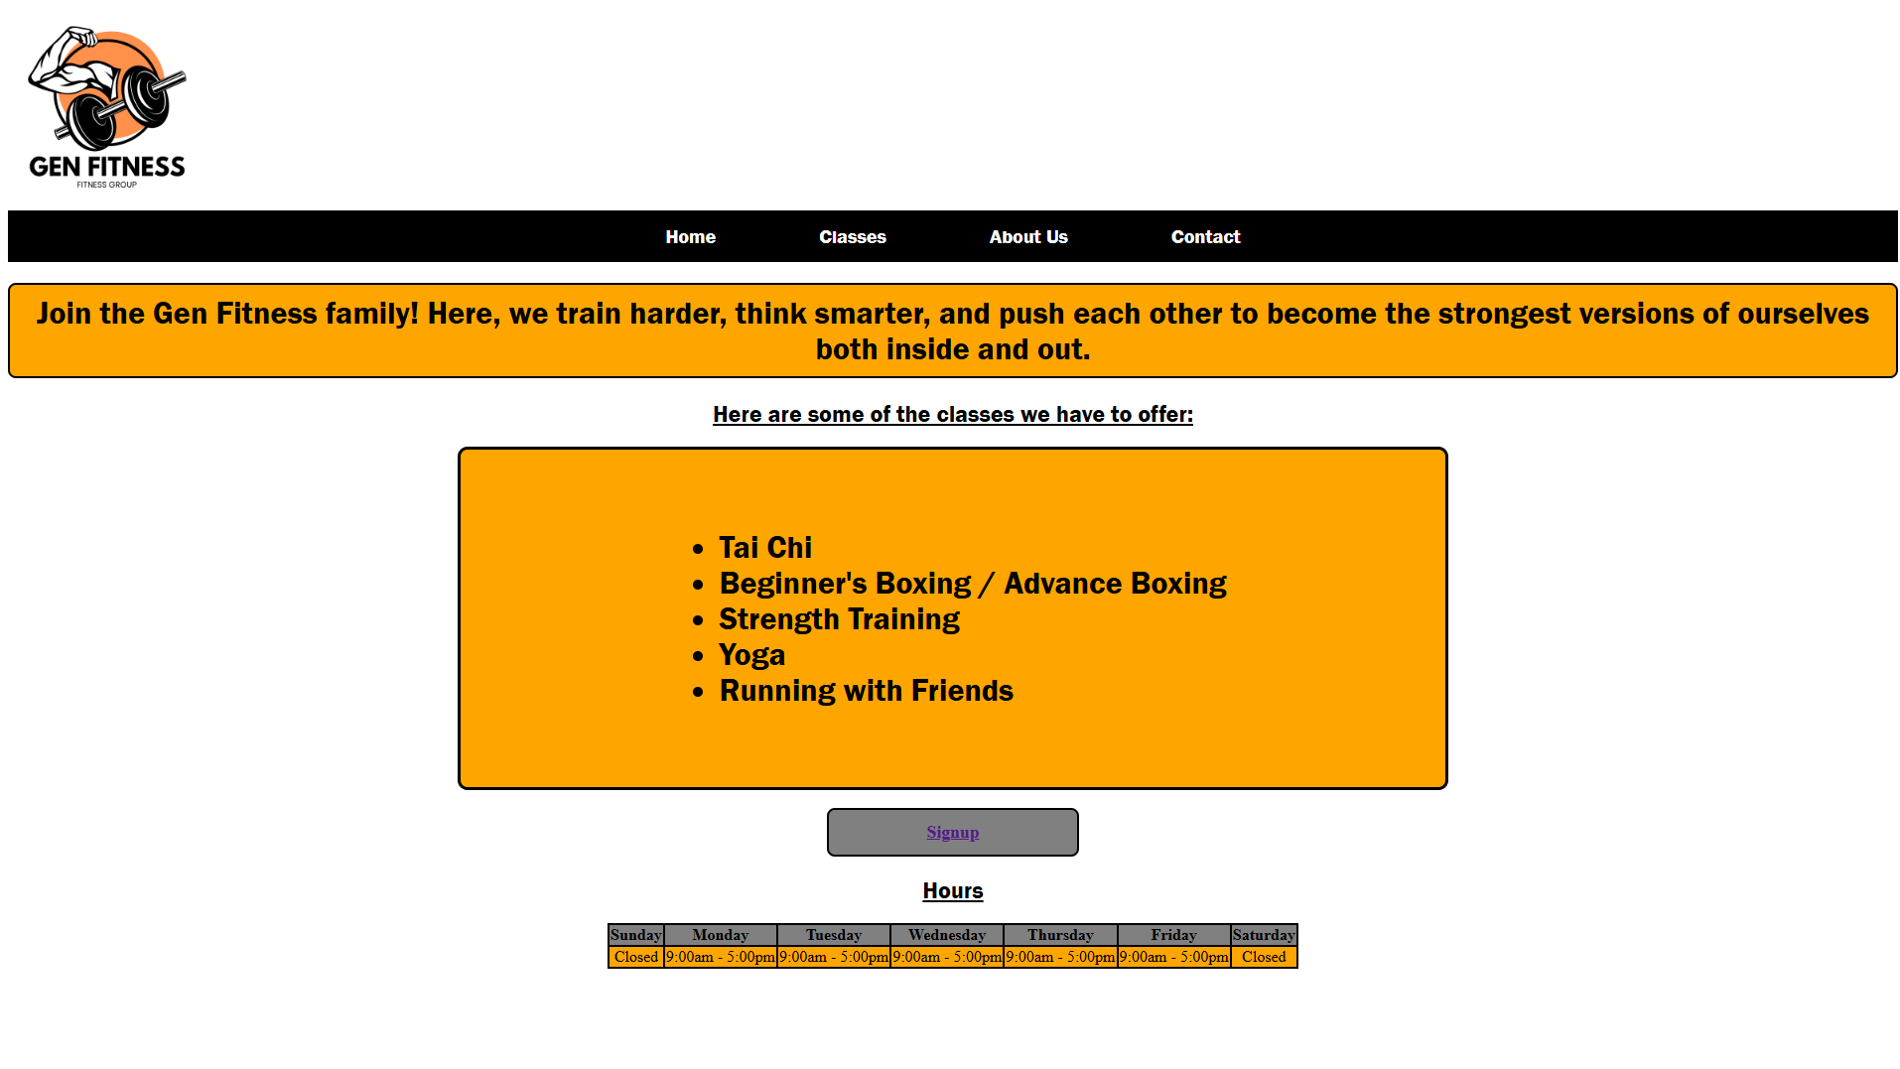



Home Page

Slide 4
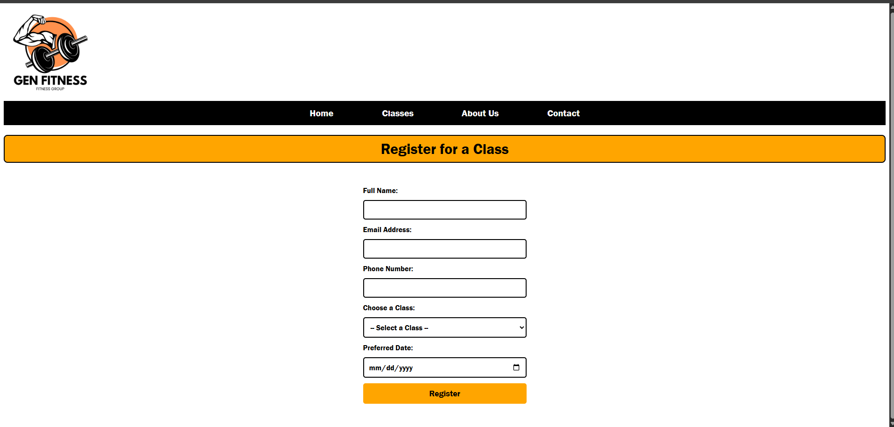
Sign Up Page

Slide 5

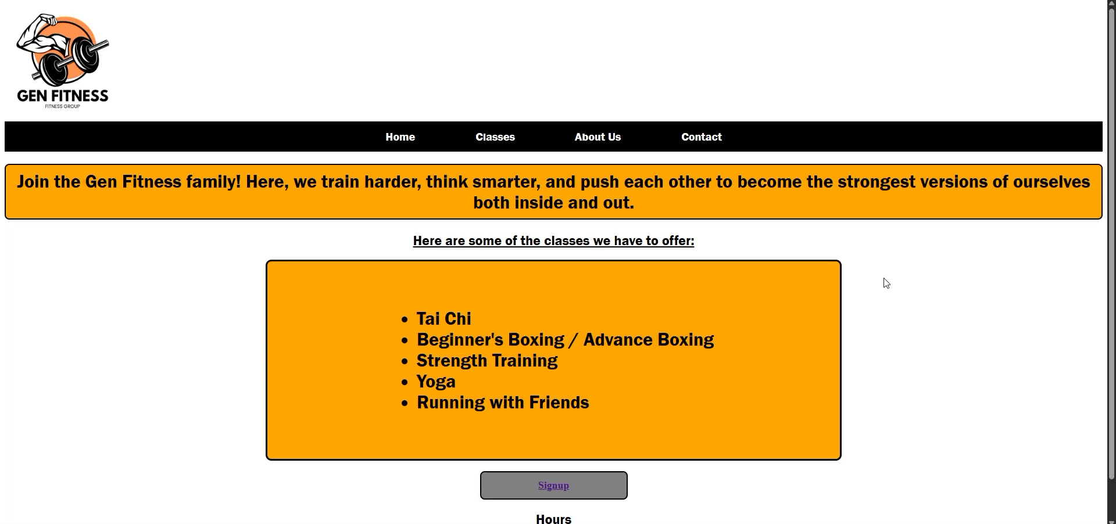

Slide 6
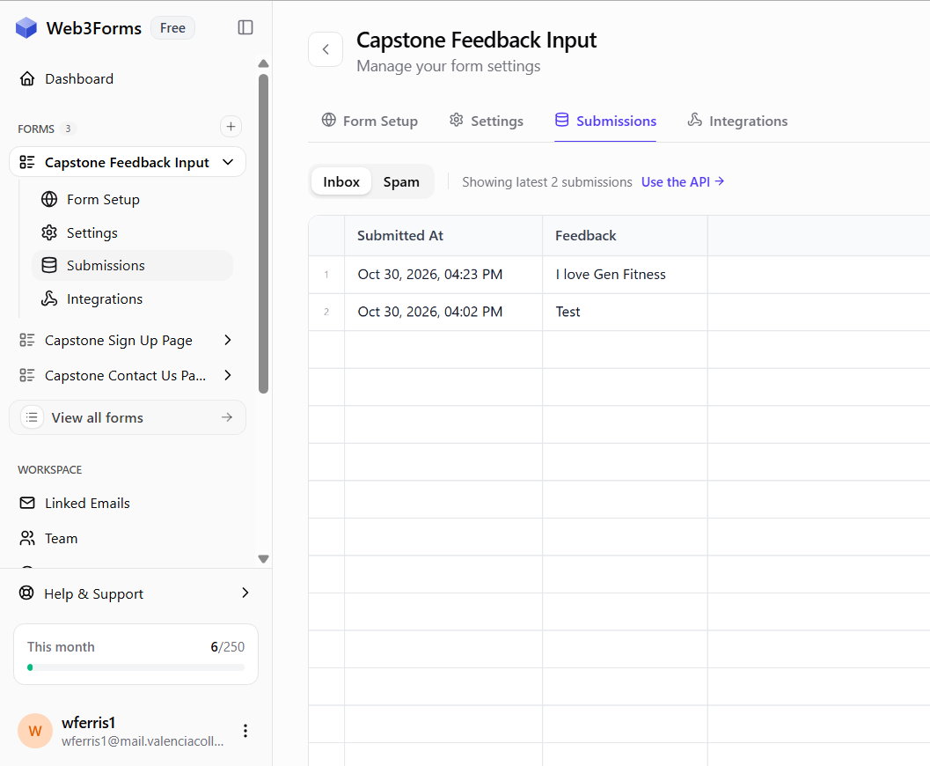
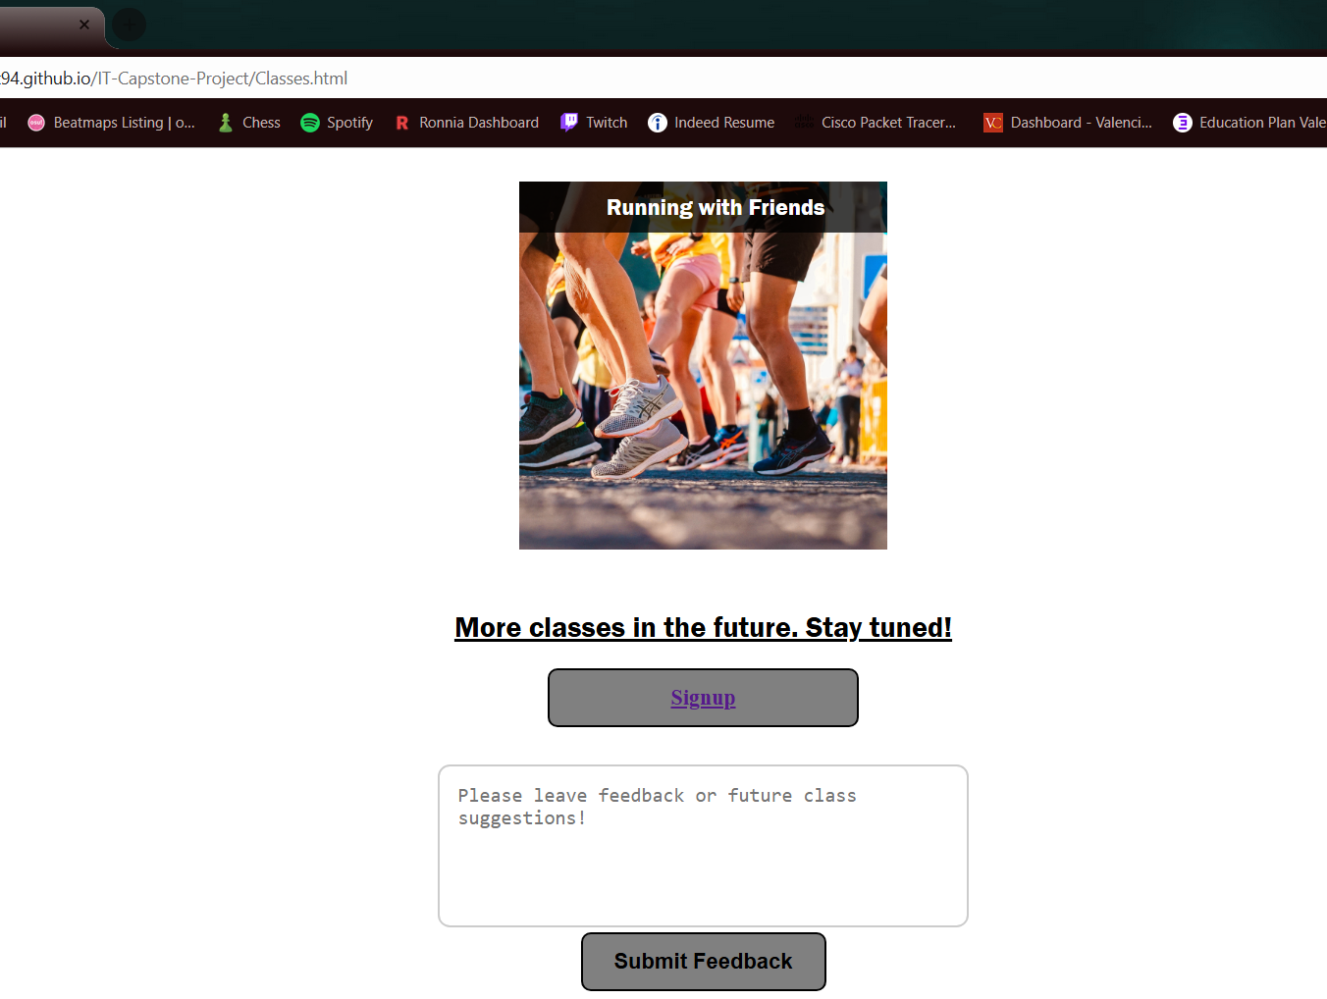
Feedback Input

Slide 7
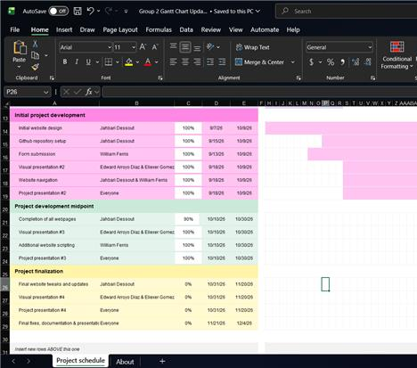
Gantt Chart

Slide 8
Roles
Website design and implementation - Jahbari Dessout
Backend and scripting - William Ferris
Project documentation - Edward Arroyo Diaz & Eliexer Gomez
Github repository management - Jahbari Dessout

